Slide 1
Ira Weiny
RDMA with FileSystem DAX
Linux Plumbers Conference 2019 – Lisbon Portugal

Slide 2
Fail Truncate overview
Let the user inform the file system that they want to “lock down” the layout of a file
    Layout lease
Allow 2 levels of layout lease
    Non-exclusive
    Exclusive
Exclusive is required to pin pages for indefinite use (such as RDMA)
Truncate fails with ETXTBSY while lease is held
Notes:
Non-exclusive – FS can take the layout away after issuing a SIGIO to the process
Exclusive – FS can not break the lease

Slide 3
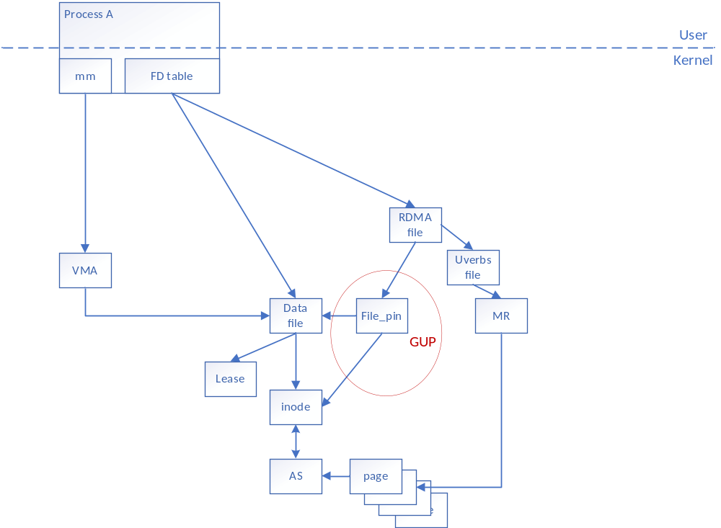
Fail Truncate
New GUP calls set up an association between Memory pinning subsystem object and the Data file being pinned
New GUP call required to pass necessary data
Notes:
1) User opens data file
2) Takes exclusive lease
3) Mmaps file
4) Opens RDMA context (FD)
5) Pins file (RDMA MR creation)
6) GUP code recognizes the pages being pinned are a file
6a) checks for exclusive lease
6b) Creates file_pin tracking object which is associated with this RDMA file
User uses memory and reverses the steps to tear everything down…

Slide 4
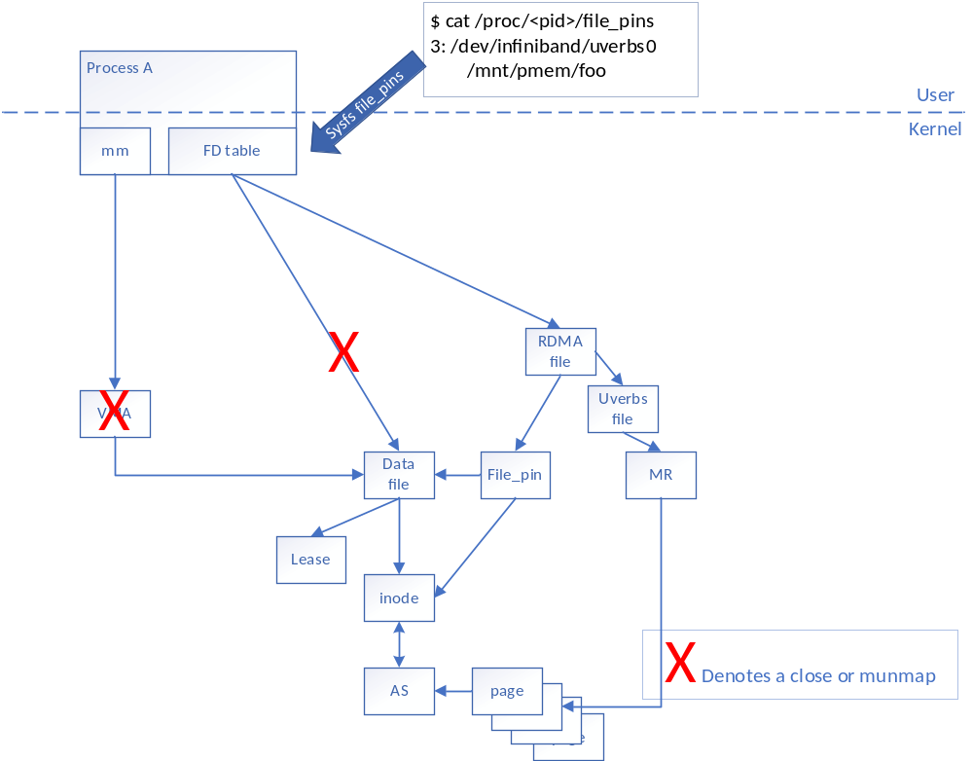
Fail Truncate
What happens if the user unmaps and/or closes the file?
Notes:
But of course it is never that simple… ☹
What if the user is not nice or just does something stupid?
Mailing list discussions indicated that as long as an admin could find out who was holding the references to the file and kill the appropriate process we would be ok.
So a new procfs entry was added.
The use of the file_pin object created by the GUP code would keep the lease and reference to the struct file around. And would provide a mechanism to find the files which were pinned by walking the fd table by the procfs code.

Slide 5
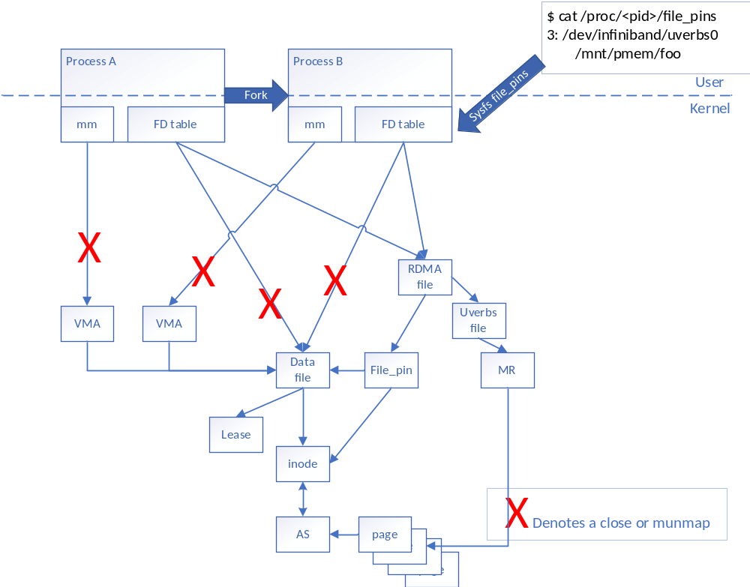
Fail Truncate
What if the process forks?
Notes:
The forked process case…

Slide 6
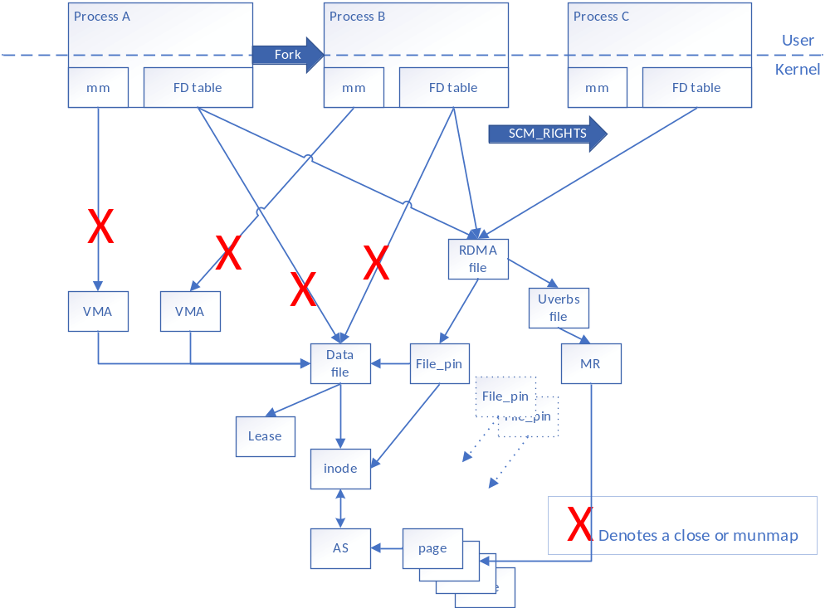
Fail Truncate
And even if the RDMA FD is passed to some random process with SCM_RIGHTS…

Slide 7
Fail Truncate – What about non-RDMA?
Other “FD” users
    XDP through socket
Hanging the file_pin information off mm_struct
    VFIO
    io_uring
$ cat /proc/<pid>/file_pins
/mnt/pmem/foo
$ cat /proc/<pid>/file_pins
4: /dev/infiniband/uverbs0
/mnt/pmem/foo
/mnt/pmem/another
/mnt/pmem/one
/mnt/pmem/another
/mnt/pmem/mm_mapped_file
Notes:
Other FD users would follow the same rules as RDMA
Patches allowed for file_pins to be hung off the mm_struct for other users. Those file pins (and zombie’d leases) would show up in the file_pins procfs entry as “stand alone” entries.

Slide 8
Fail Truncate (current patch set) Objections
RDMA “uverbs file” object can’t safely take a reference to the parent struct file
    Fixed in continued work
Lease semantics were deemed unclear
    Who owns the lease
    Who can remove the lease
    When can the lease be removed
“Zombie” Leases were not palatable

Slide 9
Fail Truncate Rework

Slide 10
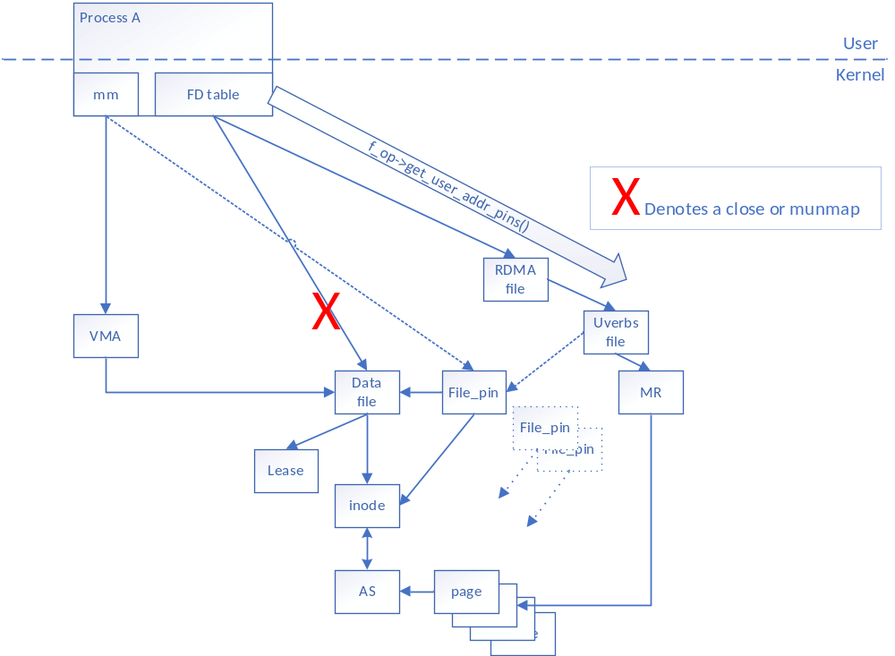
Fail Truncate
(Rework)
Hang file pins off of sub-system object
Create callback for procfs code
Problem:
    More complicated and requires more work on each sub-system
    Still allows for “zombie” leases

Slide 11
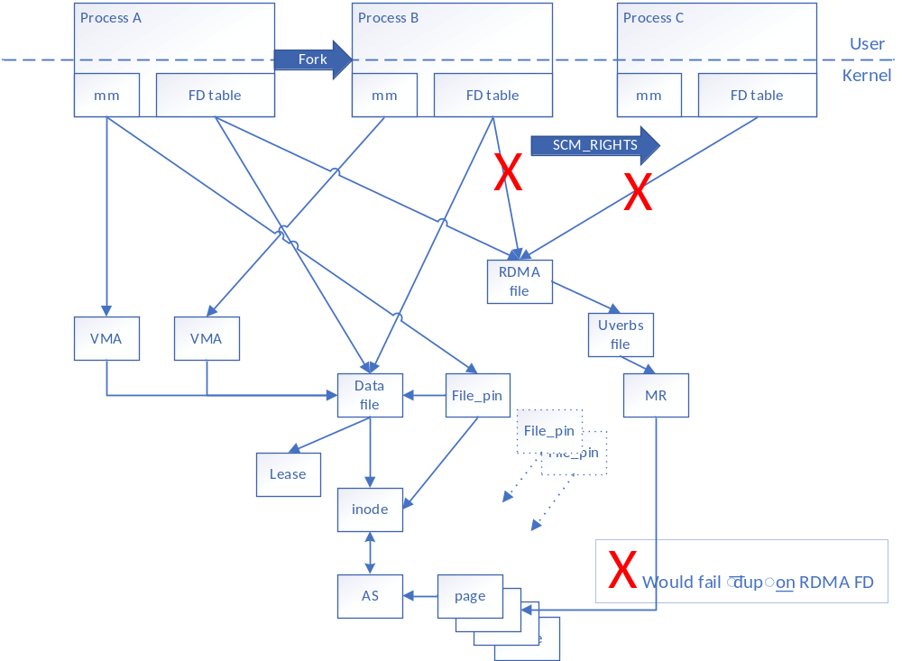
Fail Truncate
(Rework)
Fixes: Keep the lease associated with a single process?
    Fixes lease ownership issues
    Fixes required back reference
Problem: Difficult to track and close all places RDMA FD (or others) may be dup()’ed???

Slide 12
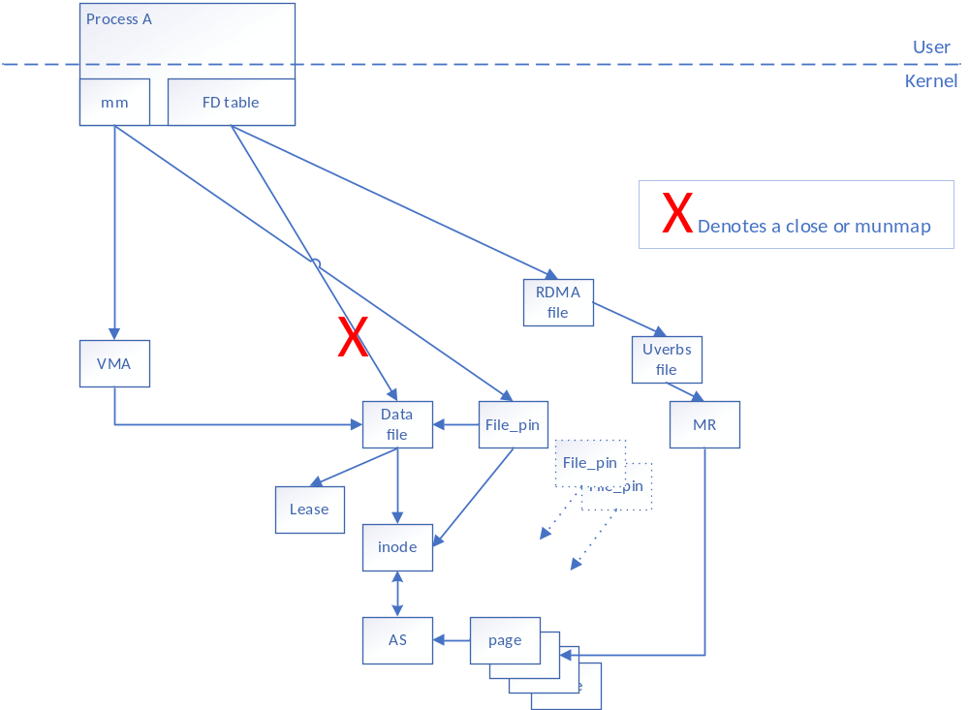
Fail Truncate
(Rework)
Fixes: Disallow close to clarify lease semantics as well as prevent “Zombie” leases
Problem: Ordering of the close of RDMA file and data file may create deadlock

Slide 13
Fail Truncate – What about non-RDMA?
Other “FD” users
    XDP through socket
Hanging the file_pin information off mm_struct
    VFIO
    io_uring
Notes:
XDP would need rework to flag the struct file as “non-dup’able”
Other users would work just fine with the file_pins hanging off the mm_struct.

Slide 14
Backup

Slide 15
Problem
FS DAX allows direct user access to pages
RDMA (and others) allow direct access to these pages through hardware registrations
Hardware registrations can not be revoked easily
File systems need to invalidate some pages on truncate (hole punch)
File system corruption and or data leaks can occur
Notes:
Bypasses the page cache
Registrations are through mmaped regions
Hardware has access to the pages. (must remain pined)
File system needs to know that an area is in use by hardware and can’t be reused even if the user has released that page.
Failure to do so can cause corruption of data and potentially security issues with data being written by RDMA hardware to pages which have been assigned to other files/users.
There is a fundamental conflict between who is in control of pages in this use case.

Slide 16
Solutions explored
Disable the feature completely
    Current state
SIGKILL process’ which attempt truncate when pages are pinned
Use bounce buffers (non-DAX page cache only)
Fail truncate/hole punch
Notes:
SIGKILL only after a notification that the layout was changing… and allowing the user to release their layout “pin” (lease)
Use of bounce buffers was discussed for non-DAX file systems only. Was a way to use other page cache pages to write data the file system deemed necessary.
Fail truncate is currently the favored approach but only after an opt-in by basically telling the file system to pin the layout through an “exclusive” layout lease.
This is because the use case for truncating data from a file which is currently pinned for RDMA is really just a programming error on the users part. Why not fail the operation and let the user sort it out.

